Slide 1
GitHub
Intro to Gitignore
South East Data & Analytics Team
england.datasouth@nhs.net
All data is for management information purposes and is not for wider circulation or publication
Notes:
Standard title slide

Slide 2

Important distinction:
To paraphrase The Great Gonzo:
Once again, I must ask you to remember – Git and GitHub are different things.
That one thing you must remember, or nothing that follows will seem wonderous

Slide 3
Quick reminder of how git talks to github
Git is a magical goblin version control software; it keeps track of what happens with files in particular folders. In effect when git tracks folders we call those folders “repos” – short for repositories. When they live on your computer they are called “local repos”
When you change a file in your project, it the goblin git only stores this change if you tell it to by “committing” that change to the repo
Once a change has been committed the magical goblin git remembers both the new state of the folder and every state that has passed before
Because git remembers the previous states, you can ask it to roll the files in the folder back to their previous position if a change needs to be reverted, this includes restoring files that have been completely deleted
Github is a special place, in a glorious land called the internet, where the goblin keeps its stuff an online git server that lets you have cloud-based repositories (“remote repos”)
If there is a repo in the cloud that you want to work on, you can make local copy of that repo on your machine (cloning the repo). That copy will have the latest state of the repo, and will also have the memory of every previous version that the remote repo has ever had
Local repositories and remote repositories can talk to each other. You can synchronise your local repository to match what is in the cloud (a pull request) or you can tell the remote repo to update itself to match what is in your local repo (a push request)
By ensuring changes you make locally are pushed into the remote repo, you have a central place where your up-to-date work on that project lives and can be accessed by colleagues who are also working on the same project
Git assumes that if you make a change, you will want to track it whether that is adding a whole file or changing a single character in a line of text

Slide 4
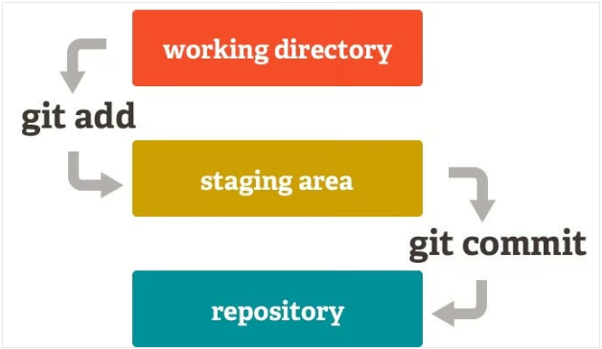
“Three tree” model of Git
Your Git project tracks three states all at once:
The Working Directory (your actual files)
The Staging Area (or index, where changes are prepared for committing)
The Repository (the committed history of your project stored in the .git directory)
Source: Hashnode

Slide 5
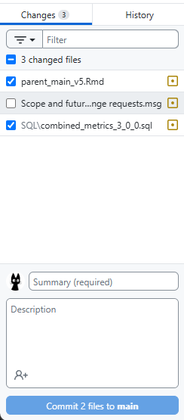
Command line Git vs other tools
To stage or not to stage, that is the question
If you are using git via the command line, you must tell it every time you want to put a file in the staging area. Changed files are not automatically tracked.
Most of us won’t be using git through the command line. We will use something like VS Code or RStudio (these are integrated development environments or IDEs), maybe together with github desktop (image on right).
These tools often try to simplify things by showing you a list of things that have been changed. It looks like they’re ready to commit (the button suggests it), but they are being presented for staging. Some tools start out with everything ticked; others are the opposite.
Staging still happens, but it is less deliberate than the command line.

Slide 6
QUIZ TIME: What do you do if your working directory has sensitive information in it?
Commit the information to the repo, sort it out later
Use an IDE but remember to un-check those files every time you’re planning to make a commit
Use command line git, manually stage everything you want to track
Somehow teach git that certain files, types of file, or files in certain places should not be tracked and so never get staged

Slide 7
Answers time: What do you do if your working directory has sensitive information in it?
Commit the information to the repo, sort it out later – NO, massive headache in the best case. IG incident in the worst case. Also NO, NO, NO, NO, NO!
Use an IDE but remember to uncheck those files every time you’re planning to make a commit – it would work, but you would have to remember to do it every single time and never make a mistake. Don’t make your life harder than it needs to be.
Use command line git, manually stage everything you want to track – Sure, lots of people do this but you still risk staging a file you didn’t mean to, especially if you use batch staging like git add * or git add . (also, the command line scares me)
Somehow teach git that certain files, types of file, or files in certain places should not be tracked and so never get staged – Oooooh what a good idea, and strangely enough exactly what a session called “intro to gitignore” is going to cover, what a coincidence!

Slide 8
.gitignore the basics
What is a .gitignore file?
A text file, simple as that
What’s in it?
A list of files, folders or file extensions you want to make sure git doesn’t track, and therefore keep off github
Do I have to list every file?
Nope, you can put in patterns and git will ignore everything that matches the pattern (handy link:
https://www.w3schools.com/git/git_ignore.asp)
Example?
*.xlsx will ignore everything the ends with .xlsx
temp/ will ignore all files inside the folder called temp
What doesn’t it do?
It won’t ignore files that are already being tracked. So, if you commit an excel file to your repo and afterwards add *.xlsx to your .gitignore, the already committed file will still be tracked.

Slide 9
How does it work?
When you tell git to stage a file (either through the command line or your IDE of choice) it checks the .gitignore. If any of the files you are committing have a name that matches a pattern in the .gitignore list git will skip those files.
Most IDEs will not show you files that match a pattern in the list, so you won’t have to remove a file from the staging list I showed earlier. Nor will you be able to check a box to stage something that should be ignored.
You can use the command line to force git to stage something that is being ignored, but if you know how to do that you probably don’t need this intro anyway.
.gitignore acts on whole files. You cannot ignore part of a file. If you have passwords, connection strings, pathways to parquet files or patient data anywhere in a file, you will need to ignore that entire file. Structure your project accordingly.

Slide 10
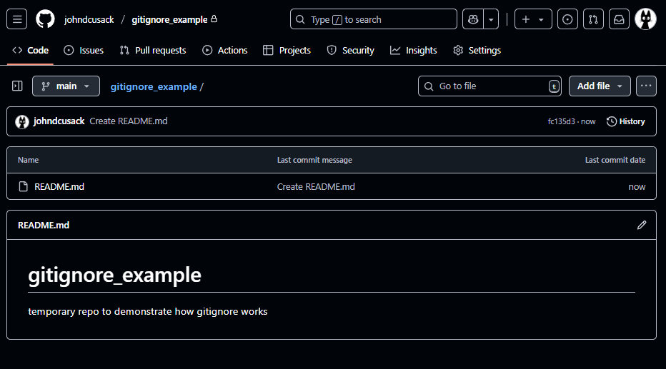
Let’s see it work with an empty repo
This is a repo I set up on github for this example.
Notice the only file it currently has is the readme

Slide 11
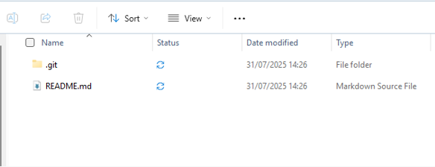

Local clone
I am legally obligated to use this meme
Here I’ve cloned the remote repository onto my laptop, it’s got the same stuff

Slide 12
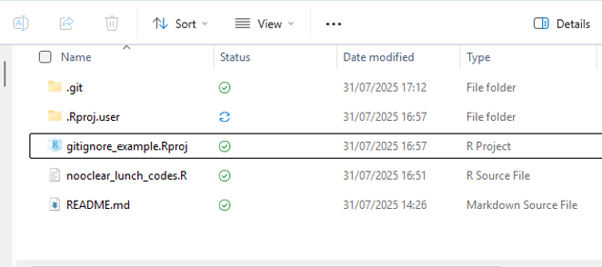
Now for some secret stuff
Now I’ve created a file that I don’t want to commit to github, because it contains important secrets.
I’ve also created an R project because I want to show you what Rstudio looks like with Git and it won’t track anything that isn’t part of an R project

Slide 13
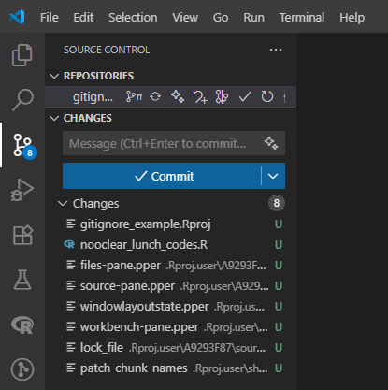
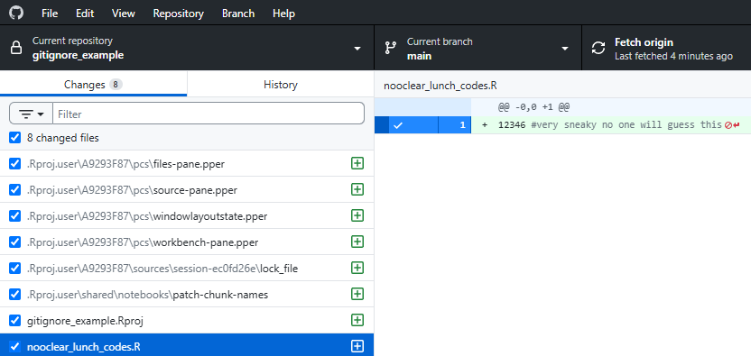
What does that look like?
Github desktop
VScode

Slide 14
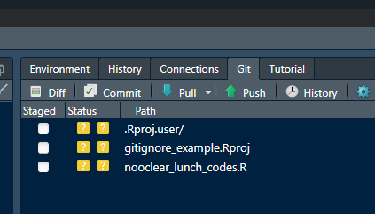
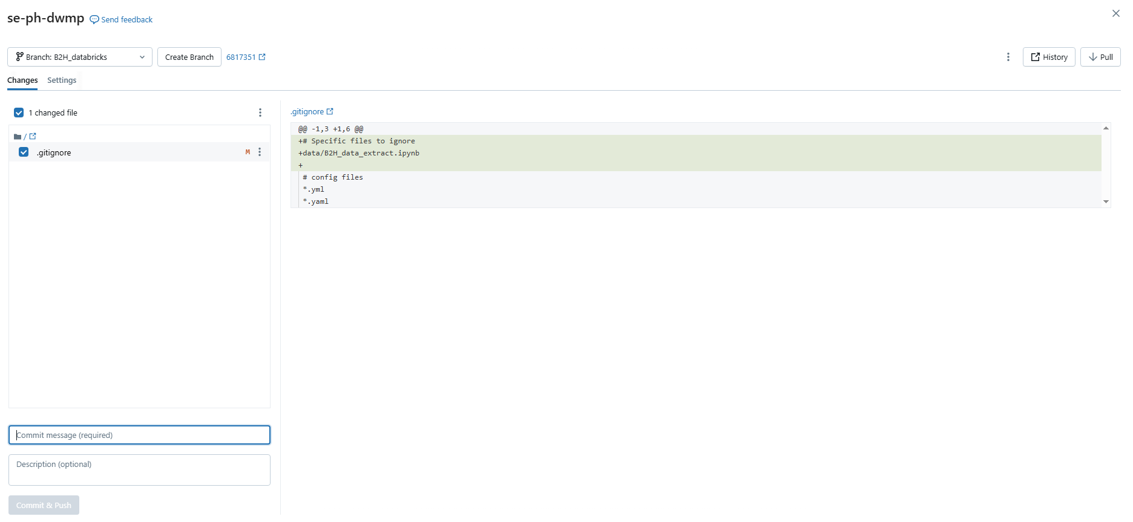
What does that look like?
Rstudio
Databricks

Slide 15
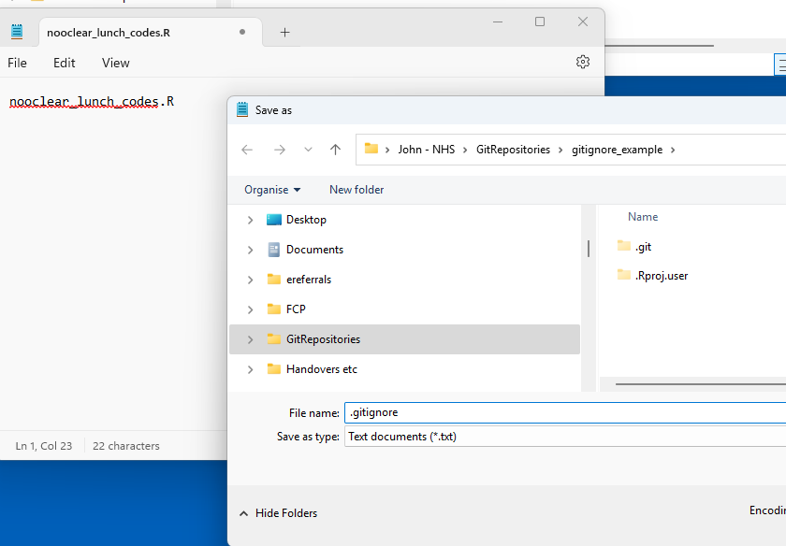
Quick ignore this!
We can fix this; we haven’t committed anything yet.
There are easier ways to get a .gitignore (see later) but to make your own just open any text editor, I’m using notepad.
Save your file with the name .gitignore (include the full stop)
Now you have a gitignore.
I’ve populated mine with the full name and extension of my special secret file

Slide 16
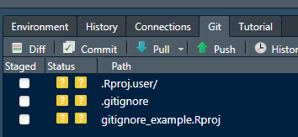
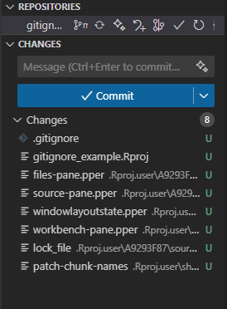
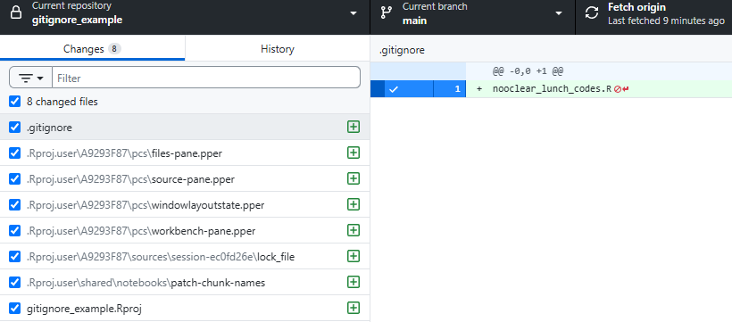
What has changed?
Rstudio
Github desktop
VScode
Notes:
We haven’t committed the file, it’s just in the folder and it is already doing its job

Slide 17
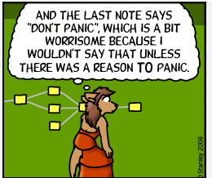
What if something slips through?
If you are working in a public repo, you must assume that everything you commit has been scraped and cannot be made secret again. Depending on what you have released you may need to follow IG incident processes
If you are working in a private repo, or if you’ve committed locally but not pushed your changes to github yet, it is possible to alter the history but it’s tricky. Reach out to the rest of the team for help
Bottom line: YOU DO NOT WANT THIS TO HAPPEN
  Set up a .gitignore at the start of every project.
  Still use your judgement. Check what you are committing every time you commit it. The .gitignore helps but you are responsible for your work

Slide 18
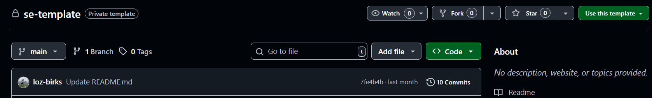
Ok you’ve scared convinced me; how do I make a .gitignore?
You don’t have to! We have set up a very extensive template that is in our team’s template repo on github: https://github.com/nhsengland/se-template-public
When making a new repo just
Then if you want to add something to the .gitignore you can add a line to the file (don’t forget to commit your change!). It is generally best practice to add lines to the top, so it is easier to quickly find the bespoke additions for that repo
If you’ve found a file extension that you think should be added to the template you can make a change to the repo itself. Don’t forget to branch and make a pull request (yay, collaboration!)

Slide 19
Task

Slide 20
.gitignore Task
If you haven’t already, clone the SE teaching repo: https://github.com/nhsengland/SE-Teaching-Repo
  (This is a private repo we created for our team as a playground for learning. If you are looking to do a similar task with your own team, we would recommend creating a similar repo using our template and adding some code files you don’t mind your team playing around with)
  You can use R/VS Code/Databricks and the relevant guides are found in the side bar here
Create your own branch (or use the branch you made last time)
This folder has several files in it. Add these files to your clone of the repository. Important: the .png and .yaml files are SENSITIVE and must only live in your clone of the repository. IT MUST NOT BE UPLOADED TO THE CLOUD VERSION OF THE REPOSITORY.
What step do you need to do before committing the changes you have made to the repository in order to make sure the .png and .yaml files only exists in your clone and not in the cloud version of the repository?
When you are happy that the sensitive files are being ignored, commit and push through the changes made to your branch

